Slide 1
Predicting One-Year Survival
After Hospital Discharge
A comparison of Cox regression, random survival forests, DeepSurv and Cox-Time
Oded Katz · Diana Morgan

Slide 2
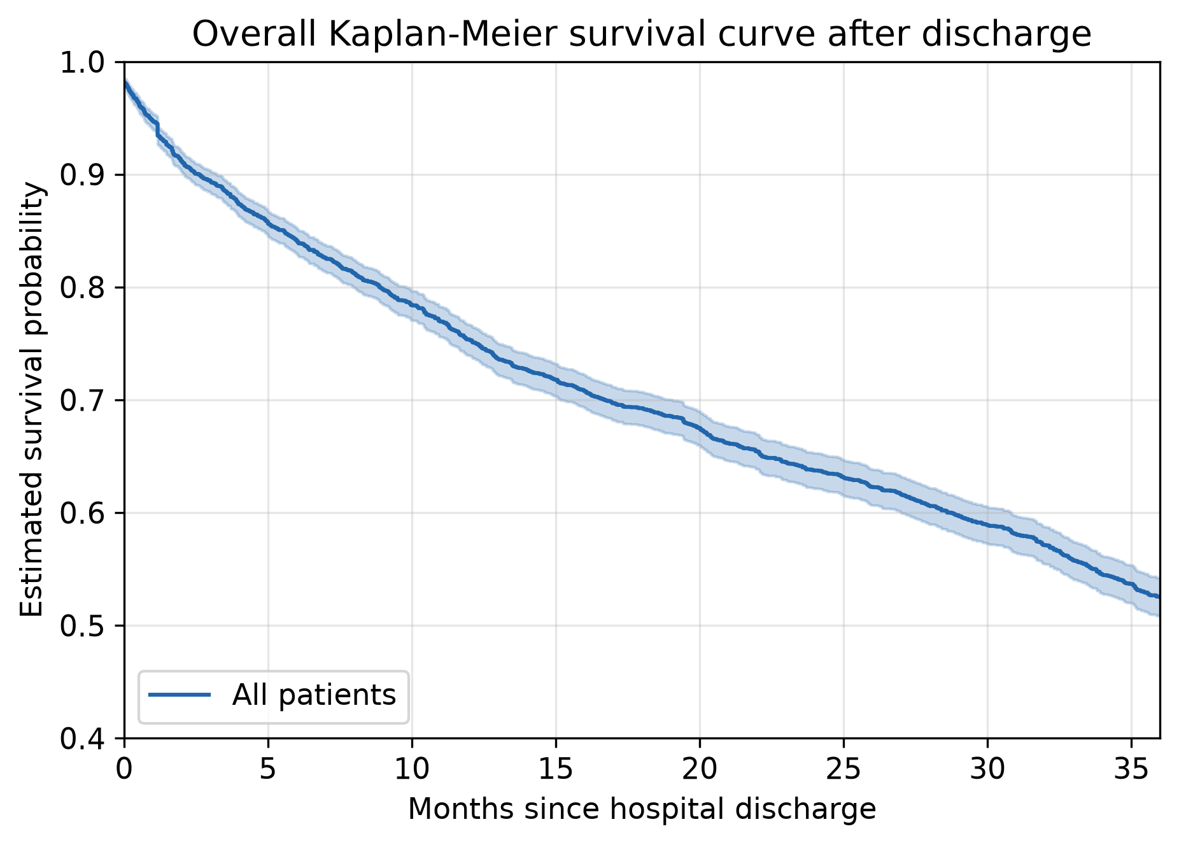
The cohort
3,961
1,679
25.6
patients discharged alive
deaths (42.4%)
months median follow-up
Acute decompensated heart failure, discharged alive; 25 covariates known at discharge
Event: death from any cause, time in months from discharge
Administrative censoring at 36 months — 1,473 of the 2,282 censored patients end there
Overall survival: 0.53 at 36 months, about 0.75 at one year
Median age 76 · 46.5% women
1
Notes:
Almost 4000 patients admitted to hospital with a heart failure and discharged alive. The data then follows up on them for up to 36 months recording death and censoring events (time in months),
after which all the remaining patient outcomes are censored.
There are 25 covariates available, composed of demographics, laboratory measurements, and prior conditions (e.g. hypertension)
About 1600 are dead at the end of the follow up, while accounting for censoring - a bit more then half survive to the end, with 75% alive at the end of one year.
Majority of censoring events are administrative – at the end of the follow up.
KM descends to 0.53 at the end of period, with steepest at the first few months, then close to linear.

Slide 3
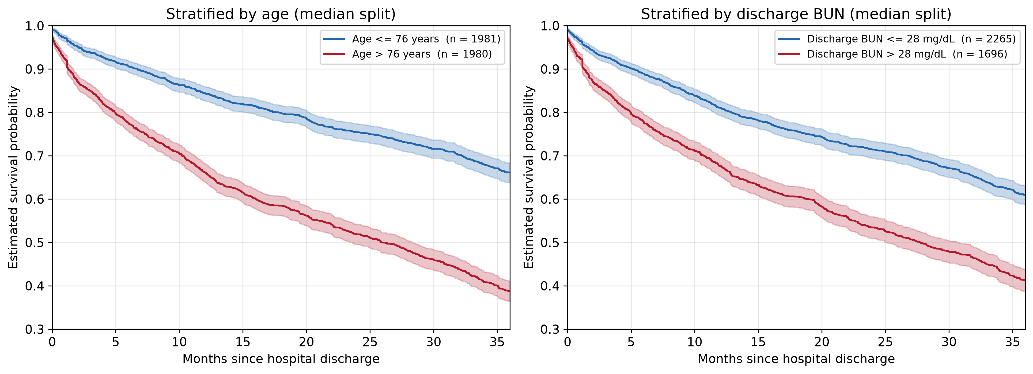
PA1: Exploration
One-year survival differs by 0.18 across age and by 0.13 across discharge BUN
Split at the medians of age (76 years) and discharge BUN (28 mg/dL).
Sex and diabetes, the stratifications our PA1 started from, separate nothing.
2
Notes:
To recap the first project assignment which mostly dealt with the exploration of the data:
We have attempted different stratifications back in PA1 – sex and diabetes – which showed to separate nothing.
Our new, more insightful stratification is, as you can see, on age and discharge BUN levels split at the median. As we can see on the graphs, older patients, as well as patients with higher BUN levels have worth outcomes.
Reminder that over all KM falls to about 0.53 at 36 months.
We see clear connection between (some) covariates and the outcome – it motivates later attempts at prediction rather well.

Slide 4
PA2: Cox model
Covariate | HR | p
Age (per year) | 1.044 | < 0.001
BUN, discharge | 1.021 | < 0.001
Sodium | 0.973 | < 0.001
BNP | 1.0002 | < 0.001
ΔBUN | 0.990 | < 0.001
RDW | 1.120 | < 0.001
Length of stay | 1.009 | 0.001
Bilirubin | 1.121 | 0.037
Potassium | 0.914 | 0.038
ΔBUN adds information
Likelihood ratio 27.63 on 1 df, p = 1.5 × 10⁻⁷
Proportional hazards possible mild violations
Schoenfeld flags discharge BUN (0.036) and length of stay (0.048)
Log-normal AFT agrees
Same directions throughout; the two diverge only in the BUN tail
+ 7 terms not associated with survival in any fit
In-sample concordance 0.694
3
Notes:
Part 2 of the assignments moves on to modeling. The Cox model we settle on includes nine significant terms, including delta BUN – a term we constructed from the difference between discharge and intake BUN levels.
It has proven to be a useful predictor via a likelihood ratio test against a model with all the variables but it. Fit on all of the data.
We see the same terms that successfully stratified in part 1 are now hold high significance as predictors.
Cox assumes three things that will be relevant later:
Linearity (--- 60 -> 70 age is same as 70 -> 80 ---),
Additivity (--- No covariate modifies another’s effects (no interaction terms) ---)
Proportional Hazards (--- baseline hazard is independent of time, depends only on the covariates X ---)
Of these we test the proportional hazards assumption with the Schoenfeld residual test, detecting two (mildly) significant variables – BUN discharge and length of stay, nothing drastic visible on the residual plots.
----------------
Reminders:
Cox models the hazard – not survival directly : h(t | X) = h0​(t) exp(β1 ​x1​+⋯+βp​ xp​) S_hat 0 ​(t)=e^(−H_hat 0​ (t) )
Baseline hazard is not estimated, use partial likelihood to fit : (given exactly one death happened now – what’s the probability it was *this* patient out of the risk set). Baselines cancel out.
HR > 1 is worse
Example: Age HR = 1.044 -> 4.4% higher hazard for one more year. 10 more years -> 1.044^10 = 1.55 = 55% higher hazard.
(hazards are multiplicative)
Concordance = shown two patients, does the model correctly say which one dies sooner?

Slide 5
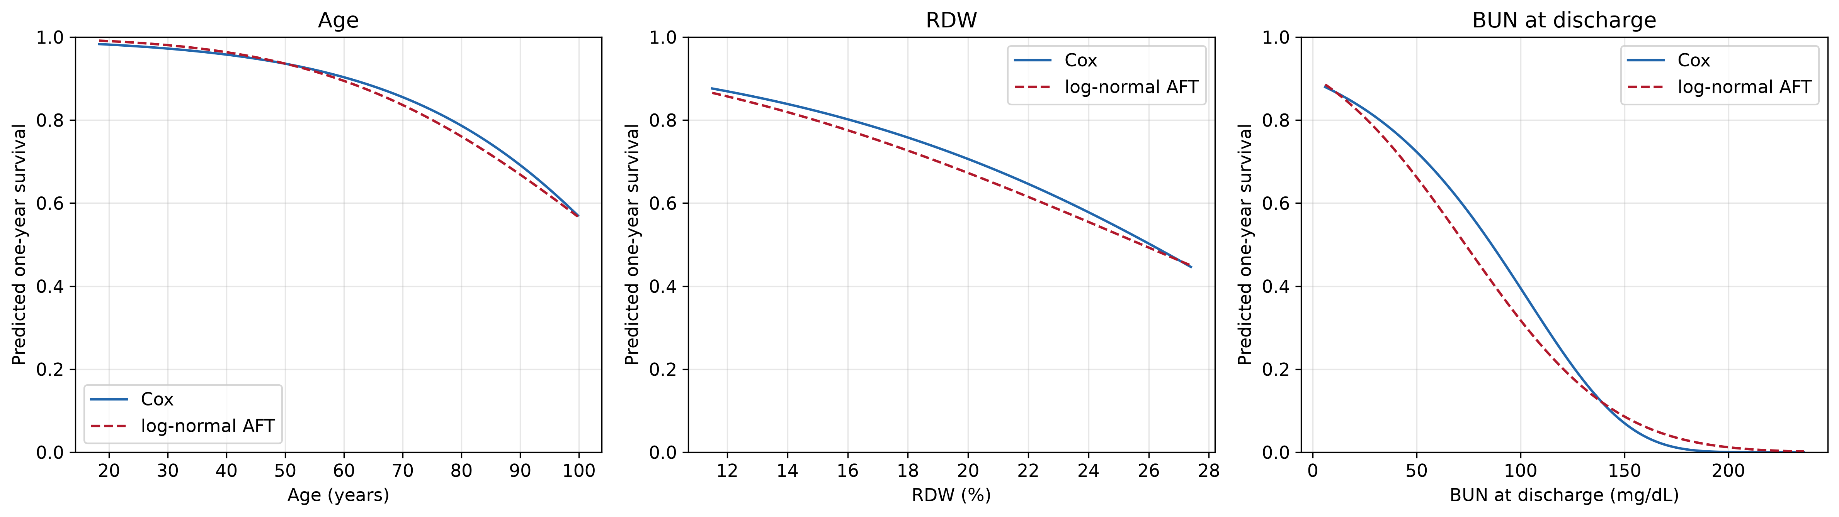
PA2: Cox against the log-normal AFT model
Backup
Full observed range. The two agree for age, separate slightly for RDW, and diverge for discharge BUN — where three quarters of patients sit below 39 mg/dL.
Notes:
Where they disagree is high BUN. And there's almost nobody there — three quarters of patients have BUN under 39, but the axis runs to 236. So the whole visible disagreement happens in a corner of the plot holding a handful of people. Out there neither model has data, so each is just guessing in its own way.
------------------
Reminders:
AFT (accelerated failure time) models survival time : logT = μ+βX + σW S(t ∣ X) = S0 ​(t / exp(βX)) ; S0 – survival curve of reference patient (X = 0), S0​(u)=1−Φ((logu−μ0​​) / σ).
In log-normal AFT W is normal distribution
In an AFT model there is only ever one survival curve. Every patient rides that same curve. Covariates change nothing about its shape — they only change how fast you travel along it.
ϕ=exp(βX) is that speed. ϕ=0.8 means this patient moves through the curve 1/0.8 = 1.25× faster than the reference. ϕ=1.2 would mean slower, i.e. better off

Slide 6
Research questions – Old Versions
1
Does the difference between BUN on admission and on discharge have a significant effect on the survival outcome?
Answered in PA2
2
Are there covariate interactions with a significant effect on the survival outcome?
105 interactions – too much to check
3
How accurately can survival be predicted at hospital discharge?
Not yet addressed
4
Notes:
We modify the questions we had in PA1
(
> RQ1 (PA1). Does the difference between BUN on admission and on discharge have a significant effect on the survival outcome?
> RQ2 (PA1). Are there covariate interactions with a significant effect on the survival outcome?
> RQ3 (PA1). How accurately can survival be predicted at hospital discharge?
)
First one was answered in PA2.
Second one – testing 105 interactions is likely to give us something significant by chance, we concentrate on two specific interactions instead.
Third – still of interest, not yet addressed

Slide 7
Research questions – Improved and Adjusted
1
How accurately can one-year survival be predicted at discharge — and do the more flexible models beat Cox?
the four models are compared once, on the held-out test set
2
Where the flexible models differ from Cox, which of the Cox model's assumptions is responsible?
linearity · additivity · proportional hazards
3
Do two pre-specified interactions improve on the additive Cox model?
ΔBUN × discharge BUN · age × discharge BUN
4
Notes:
RQ1: PA1's third question improved.
RQ2: We relax different assumptions as we move on to different models and observe what has a true effect on the modeling. This is especially motivated by mild but present PH violation we found earlier
RQ3: We select two specific interactions that make sense:
Delta-BUN with discharge BUN are likely to affect one another, as the change is likely to have different strange of effect on different numeric levels of BUN
Age with discharge BUN are the two strongest predictors – their potential interaction is the most interesting one to explore.

Slide 8
Train–test split
Training · 3,168 patients
Test · 793
80%
20%
Stratified by the event indicator — 42.4% events in both sets
748 deaths within 12 months in training · 199 in test
5
Notes:
80/20, stratified by the event indicator so the event rate — 42.4% — is identical in both sets.
Training 3,168 patients, 1,343 events, 748 deaths within 12 months. Test 793 patients, 336 events, 199 deaths within 12 months.

Slide 9
The Cox model refitted on training data
No hazard ratio moves by more than 2.2%
Covariate | HR train | HR full | p train | p full
Age (per year) | 1.0447 | 1.0438 | < 0.001 | < 0.001
BUN, discharge | 1.0238 | 1.0213 | < 0.001 | < 0.001
RDW | 1.1295 | 1.1204 | < 0.001 | < 0.001
ΔBUN | 0.9900 | 0.9903 | < 0.001 | < 0.001
BNP | 1.0002 | 1.0002 | < 0.001 | < 0.001
Sodium | 0.9726 | 0.9728 | < 0.001 | < 0.001
Length of stay | 1.0083 | 1.0094 | 0.010 | 0.001
Bilirubin | 1.0988 | 1.1208 | 0.126 | 0.037
Potassium | 0.9196 | 0.9141 | 0.078 | 0.038
Every full-data estimate falls inside the training confidence interval. Concordance 0.699 against 0.694.
Bilirubin and potassium lose significance — the intervals widen, the effects do not move.
6
Notes:
Same model, training patients only, with the full-data estimates alongside.
I wouldn’t waste our time going into it too deeply, the main point is – nothing has moved too significantly from the full data model, estimates are stable.
The exception is Potassium and Bilirubin losing significance – likely from widening of the confidence intervals.
Seven terms remain significant with essentially unchanged hazard ratios
(maybe: "The hazard ratio below 1 isn't saying a rise in BUN is good — with discharge BUN already in the model, it's saying that starting higher is bad.“)

Slide 10
Proportional hazards on the training data
No covariate is flagged in both fits
Covariate | p (train) | p (full)
Comorbidity burden 4+ | 0.021 | 0.100
Comorbidity burden 2–3 | 0.025 | 0.239
Bilirubin | 0.035 | 0.117
BUN, discharge | 0.116 | 0.036
Length of stay | 0.137 | 0.048
Training is four fifths of the same cohort — a genuinely time-varying effect would persist in it
Smallest p anywhere in either fit: 0.021, across sixteen simultaneous tests
Schoenfeld residual test on a rank transform of time; flagged at p < 0.05
7
Notes:
Same Schoenfeld test,
The training set is not independent data — it is four fifths of the same cohort. A hazard ratio that genuinely varied over follow-up would still vary in that subset. Flags that swap like this look like noise, especially so close to p-value threshhold
We conclude that PH assumption likely holds.

Slide 11
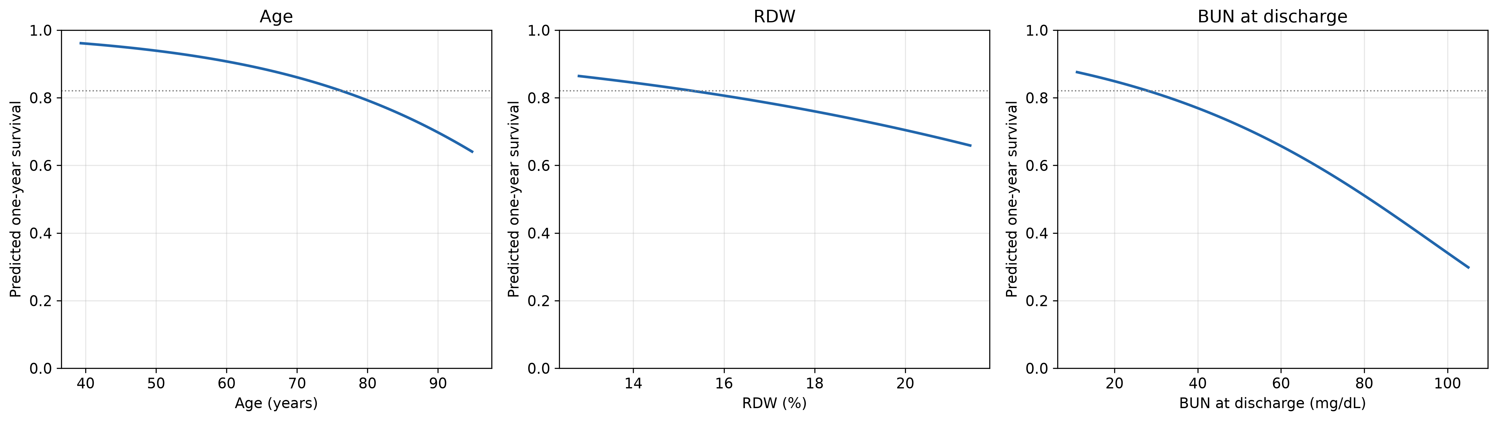
One-year survival prediction
Grids run from the 1st to the 99th training percentile. Dotted line: the representative patient.
Representative patient — a man of 76 with median labs — has predicted one-year survival 0.821
Across the plotted grid
Over the interquartile range the order reverses
BUN 0.876 → 0.298 · age 0.962 → 0.641 · RDW 0.864 → 0.659
age 0.11 · BUN 0.06 · RDW 0.03
8
Notes:
In practical terms, the baseline one-year survival is 82%. Because the covariates are centred, that corresponds to a patient with average characteristics in the training data, not to a patient for whom every covariate is zero.
The representative patient is medians for continuous covariates and the most common level for comorbidity burden.
The grids run from the 1st to the 99th percentile rather than min to max (remove extreme outliers): discharge BUN reaches 199.7 in the training set but its upper quartile is 38, so a full-range axis would spend most of its length where almost no patients are.
interquartile range = Q3 – Q1 – middle 50%
So, age matters most for a typical patient, while discharge BUN dominates the plotted range because of its long right tail and matters most for the minority discharged with high values.
All three curves have the same basic shape: they decline and then level off. But that shape comes from the way the Cox model is specified; it is not something we learned from the data. The flexible models let us check whether the data actually support that pattern.
----------
Reminders
Breslow baseline :
go through the data and count deaths as they happen, but instead of counting each person at risk as one person, count them by how sick the model says they are. A high-risk patient counts as more than one. That gives you a curve for someone of average sickness.
Then you get any individual patient's prediction by pushing that curve down (for riskier patients) or up (for safer ones).

Slide 12
Three more flexible models
Each model drops a different Cox assumption
 | Cox | DeepSurv | Cox-Time | RSF
Risk score | β′x | g(x; θ) | g(t, x; θ) | none (tree splits)
Linearity | assumed | relaxed | relaxed | relaxed
Additivity | assumed | relaxed | relaxed | relaxed
Proportional hazards | assumed | assumed | relaxed | relaxed
Fitted by | partial lik. | partial lik. (mini-batch) | partial lik. (sampled) | log-rank splits
Baseline hazard | Breslow | Breslow | Breslow | Nelson–Aalen (leaf)
Tuning — 5-fold CV in the training set, scored by IBS over the first year, one-SE rule.
Selected: RSF 500 trees / leaf 50 / mtry 4 · DeepSurv [16], dropout 0.4, lr 0.001 · Cox-Time [16], dropout 0.4, lr 0.01
All four CV scores land within one SE of each other (IBS 0.110 ± 0.003).
9
Notes:
Three models, one idea: each one removes a different Cox assumption, so whatever changes in the results tells us which assumption was costing us.
Read the table down the proportional hazards row — that's the interesting one. DeepSurv is still a PH model: it only replaces the linear predictor with a network g(x), so the hazard ratio between two patients is exp{g(x1) - g(x2)}, which has no t in it. Cox-Time puts time inside the network, g(t, x), so that ratio can move over follow-up. The forest assumes nothing at all — no baseline hazard, no risk score. It splits on the log-rank statistic and reads a Nelson-Aalen estimate out of the leaf, averaged over 500 trees.
Same sixteen design terms and the same training patients for all four models, so any difference is the model and not the inputs.
Tuning: 5-fold CV inside the training set only, scored by the integrated Brier score over the first year, so tuning and final evaluation target the same quantity. One-SE rule — take the simplest configuration within one standard error of the best. Every model landed at the least flexible end of its grid: the forest at leaf 50 and 4 features, both networks at a single 16-unit layer with the higher dropout. And all four CV scores sit inside one SE of each other. That is essentially the answer to the whole project, arriving before we ever touch the test set.
Test set still untouched at this point.
----------------
Reminders:
Why case-control sampling for Cox-Time: the full partial likelihood would need the network evaluated at every event time for everyone still at risk. We sample one control per event instead.
Leaf 50 at a 42% event rate is about 21 events per leaf — that is what makes the forest's curves flatten later.
Breslow baseline is fitted after training, from the estimated risk scores.
Why not a single validation split: only about a fifth of the cohort dies within the year, so one split is noisy. CV reuses the same folds for all three models.

Slide 13
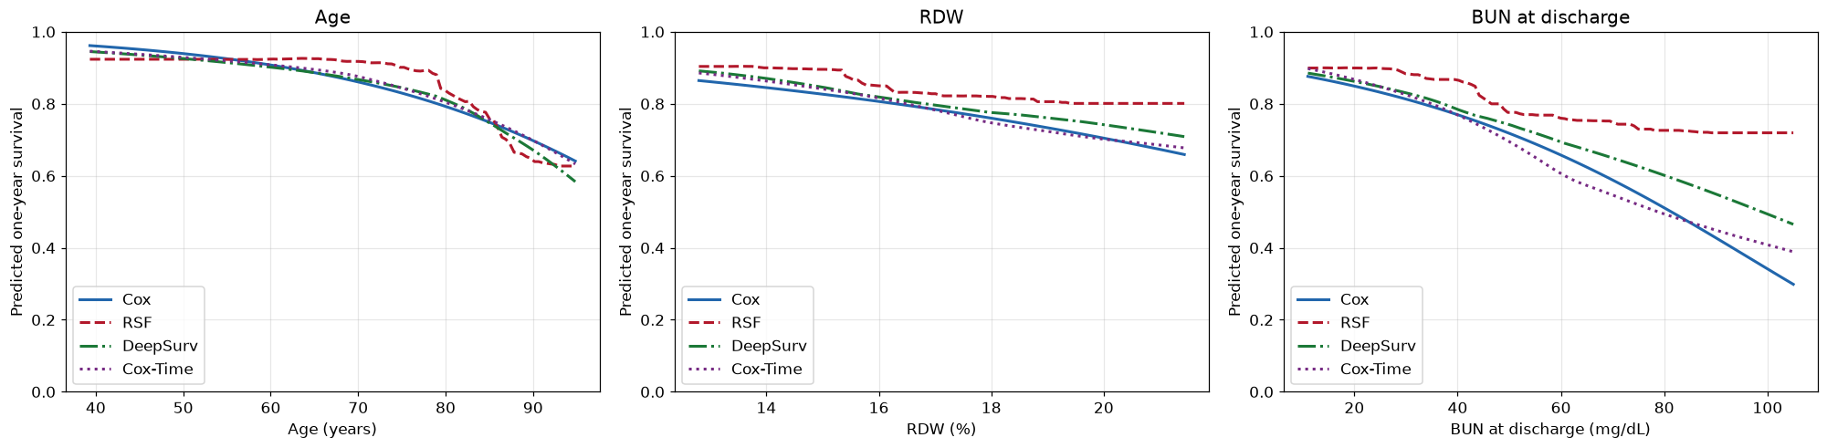
Do the flexible models see the covariates differently?
They agree over the IQR, where most patients lie — and disagree mainly in the sparse tails
Drop over the IQR — age: all four rank it first
Top of the BUN grid — models diverge most
Cox 0.110 · RSF 0.118 · DeepSurv 0.105 · Cox-Time 0.114
Cox 0.298 · Cox-Time 0.389 · DeepSurv 0.465 · RSF 0.719
10
Notes:
Same grids and the same representative patient as the Cox-only plots — 1st to 99th training percentile, everything else held at its median. So the four curves are directly comparable.
Over the interquartile range, where nearly all patients actually sit, the four models lie on top of each other. The age numbers are 0.110, 0.118, 0.105, 0.114, and all four rank age as the strongest covariate. The forest is the only one that reorders the other two, putting RDW above discharge BUN.
Where they split is the tails, and BUN is the clearest case. At the top of the grid Cox says 0.30 and the forest says 0.72 — a huge disagreement about the same patient. But look at what is out there: above roughly 75 mg/dL there is about 4% of the training set. The forest flattens because a leaf of 50 cannot split any further out there, and Cox keeps falling because a straight line on the log-hazard scale does not stop. Neither is evidence about biology; both are extrapolation.
So for RQ2: no non-linearity that Cox is missing where the data actually are.
----------------
Reminders:
DeepSurv tracks Cox to about 40 mg/dL and then bends upward; Cox-Time runs slightly below it through the middle of the range and crosses back above at the end.
Age is where the models agree most closely — visible divergence only past about 85 years.
The full numbers for all three covariates are on a backup slide.

Slide 14
Test-set model comparison (RQ1)
793 test patients, used once | no model is meaningfully better than Cox
Model | Uno's C, τ = 12 mo ranks patients correctly | IBS, 0–12 mo squared error over the year | Mean |obs − pred| decile calibration gap
Cox | 0.6959 | 0.1150 | 0.0367
RSF | 0.6805 | 0.1169 | 0.0385
DeepSurv | 0.6909 | 0.1153 | 0.0420
Cox-Time | 0.6967 | 0.1142 | 0.0422
Cox-Time beats Cox by 0.0008 on both measures — with 199 one-year deaths, that is not a ranking.
Cox, DeepSurv and Cox-Time are essentially equivalent; only the forest trails consistently.
11
Notes:
This is the first and only time the test set is used. 793 patients, 199 of them dying within the year.
Three measures because they ask three different questions. Uno's C asks whether we order patients correctly — shown two patients, does the model say which one dies sooner. IBS asks how far the whole predicted survival curve is from what actually happened, squared and averaged over the first twelve months. The calibration column asks whether a predicted 0.8 really means 80% survive.
The numbers cluster: C around 0.69 and IBS around 0.115 for everyone. Cox-Time is top on two of the three, but it beats Cox by 0.0008 — with 199 events that is not a result, and I want to be explicit that we are not claiming Cox-Time won. Cox, DeepSurv and Cox-Time are indistinguishable; the forest is the only one consistently behind on all three.
The one thing that does separate them is the spread of the predictions rather than the average. The forest never predicts below 0.44, while Cox has the widest range and puts two extreme-BUN patients near zero, one of them beyond the training maximum. Same tail story as the previous slide.
----------------
Reminders:
Uno's C uses inverse-probability-of-censoring weights estimated from the training data, so the estimate is not distorted by the censoring distribution. Harrell's C would be.
IBS uses IPCW Brier scores at months 1 to 12, trapezoidal rule, with BS(0) = 0 because everyone is alive at discharge and every model predicts S(0) = 1.
Calibration: deciles of predicted survival, observed estimated by Kaplan-Meier within each decile rather than a raw proportion, because every decile contains patients censored before 12 months. About 80 patients per decile, so the intervals are wide.
The calibration plot is a backup slide. Cox has the lowest error but separates two low-survival deciles the observed data do not distinguish; DeepSurv has the single largest miss; Cox-Time has several small deviations, which is why it is last on a mean-absolute measure without any severe miss.
Test scores are slightly worse than the CV values, as expected on unseen patients.

Slide 15
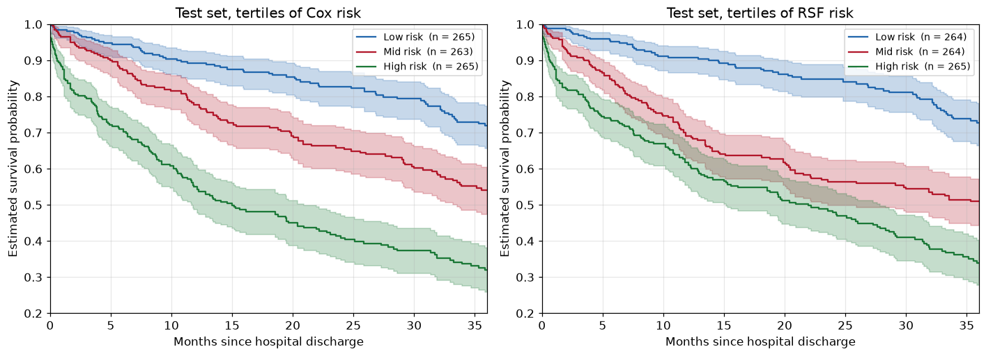
Do the models flag the same patients?
Equal C-indices could hide different rankings. They mostly do not.
Cox, DeepSurv and Cox-Time: Spearman ≥ 0.976, sharing ~88% of the top-risk quintile
Cox ↔ RSF: Spearman 0.884, sharing 71% · Cox tertiles 0.89/0.78/0.55 · RSF compresses mid & high to <0.08 apart
12
Notes:
A fair objection to the previous slide: four models can have the same C-index and still disagree completely about who is high risk. So we checked directly.
They do not disagree. Cox, DeepSurv and Cox-Time have Spearman correlations of at least 0.976 on predicted risk and share about 88% of their top-risk quintile — roughly 140 of the same 159 patients. The forest is the outlier at 0.884 and 71%.
The plot is what that means in practice. Split the test set into tertiles of predicted risk under each model and draw Kaplan-Meier. Cox gives 0.89, 0.78 and 0.55 at one year, with confidence bands that stay apart the whole way. The forest gets the low-risk group right and then collapses the middle and high groups to less than 0.08 apart with overlapping bands — it is calling two groups different when their outcomes are not. That is the same fact as the C-index gap in the table, but in the form a clinician would care about.
----------------
Reminders:
Quintiles are 159 patients each; tertiles are 263 to 265 each.
The full correlation matrix and all six pairwise overlaps are on a backup slide.
Why the forest compresses: its predictions are averages of leaf-level survival estimates, so they cannot go beyond the outcomes represented in the leaves.

Slide 16
Performance in clinically meaningful subgroups
Split where the models disagreed most; the ranking barely moves (Uno's C)
Subgroup | n (deaths) | Cox | RSF | DeepSurv | Cox-Time
BUN ≤ 28 mg/dL | 430 (81) | 0.7140 | 0.6946 | 0.7018 | 0.7079
BUN > 28 mg/dL | 363 (118) | 0.6361 | 0.6173 | 0.6346 | 0.6349
Age ≤ 76 years | 406 (62) | 0.6663 | 0.7010 | 0.6785 | 0.6815
Age > 76 years | 387 (137) | 0.6172 | 0.5800 | 0.6085 | 0.6203
The only reversal is RSF among the younger group (62 deaths) — likely noise.
13
Notes:
We picked the subgroups where the earlier plots said the models disagree — discharge BUN and age — and cut at the training medians, so the cut points do not depend on the test data.
The ranking barely moves. Cox is best in both BUN groups and the forest is worst in both. The only reversal anywhere is the forest coming top among patients 76 and under, and that group holds 62 of the 199 one-year deaths, so I would not lean on it.
The more interesting line is how much harder the high-risk halves are. C drops from 0.71 to 0.64 across the BUN split and from 0.67 to 0.62 across the age split. Every model struggles where the patients are sickest, and that is the real ceiling here.
Note also that BUN produced the largest visual disagreement two slides ago and produces no reversal here. That is consistent with our reading: the disagreement lives in the extreme tail, and a median split dilutes it.
----------------
Reminders:
IBS by subgroup is on the backup slide. Cox-Time is lowest in three of the four subgroups, all margins tiny.
Subgroup C-indices are not comparable to the overall value — restricting the range of risk mechanically lowers concordance.

Slide 17
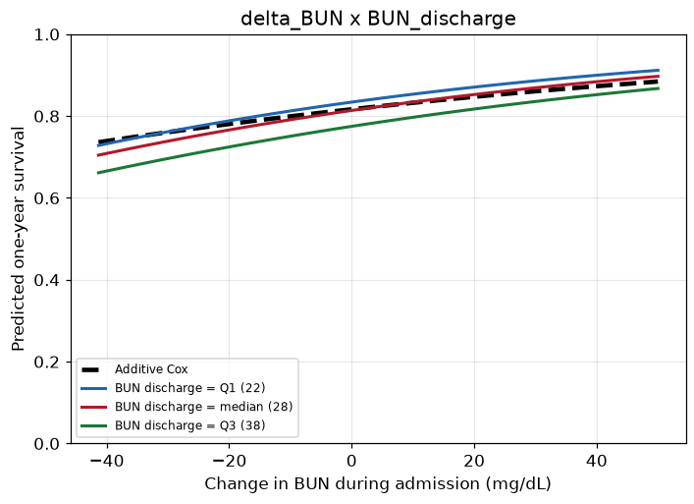
Two pre-specified interactions (RQ3)
One is statistically significant. Neither improves prediction.
Interaction | HR | LR stat (1 df) | p | vs. threshold 0.025
ΔBUN × BUN, discharge | 1.0001 | 5.85 | 0.016 | significant
Age × BUN, discharge | 1.0001 | 0.29 | 0.592 | no evidence
14
Statistically detectable, not predictively useful: adding it gives test C 0.6933 vs 0.6959, IBS 0.1152 vs 0.1150.
Notes:
Both interactions were specified in advance, before looking at any result. That matters: 105 covariate pairs would have handed us something significant by chance, which is exactly why we reframed the PA1 question. Bonferroni for two tests gives a threshold of 0.025.
Delta-BUN with discharge BUN clears it — likelihood ratio 5.85 on one degree of freedom, p = 0.016. The plot is the interpretation: the curves for different discharge BUN levels are not parallel, so the effect of a change in BUN during admission depends on the level the patient was discharged at. Age with discharge BUN gives nothing, p = 0.59, and its curves stay parallel — that figure is on a backup slide.
Then the punchline. Adding the significant interaction makes prediction very slightly worse: test C goes from 0.6959 to 0.6933, test IBS is unchanged to three decimals, and cross-validated IBS moves by far less than the fold-to-fold standard error of 0.0030. Statistically detectable, not predictively useful. That is the answer to RQ3, and a clean illustration that significance and prediction are different questions.
----------------
Reminders:
The HR of 1.0001 looks like nothing because it is per unit of a product of two variables in mg/dL; across the observed range it is not negligible.
Delta-BUN's own HR below 1 is not 'rising BUN is good'. With discharge BUN already in the model, it says that among two patients discharged at the same level, the one who started higher does worse. 0.990 per mg/dL of delta-BUN is the same statement as 1.010 per mg/dL of admission BUN.
Interactions were tested in the Cox model because that is where a term can be added and tested directly. The flexible models can represent interactions but do not give you a test for one.

Slide 18
Conclusions
1
C ≈ 0.69, IBS ≈ 0.115 at one year from discharge information
No flexible model improves on Cox; the forest is the only one consistently worse
2
None, detectably
DeepSurv and Cox-Time match Cox on predictions and on individual patients (ρ ≥ 0.976); disagreement is confined to sparse tails
3
ΔBUN × discharge BUN is significant (p = 0.016) but does not improve prediction
Age × discharge BUN: no evidence
Strongest predictors — age (largest over the IQR, ~2× BUN, ~3× RDW), discharge BUN, RDW, BNP, length of stay ↑ hazard; sodium and ΔBUN ↓ hazard
Limitations — synthetic data · one 80/20 split at one seed · one-year horizon only · 199 one-year test deaths limit resolution · IPCW assumes censoring independent of survival given covariates · no external validation
15
Notes:
Three questions, three answers, in the order we asked them.
One. About 0.69 concordance and 0.115 IBS at one year from what is known at discharge. That is moderate — useful for sorting patients into risk groups, not for an individual decision. And no flexible model beat Cox; the forest was the only one consistently worse.
Two. No assumption turned out to be the bottleneck. DeepSurv drops linearity and additivity, Cox-Time additionally drops proportional hazards, and both land on the same predictions and very nearly the same individual rankings as Cox. That fits the Schoenfeld results, where no covariate was flagged in both fits.
Three. The delta-BUN by discharge BUN interaction is real but does not improve prediction.
If I had to say what the project actually shows: the ceiling here is the information available at discharge, not the model class. Flexibility bought nothing because there was not much left to buy.
Limitations briefly — synthetic data, so external validity is limited; one split at one seed, so the test numbers carry sampling noise we have not quantified; a single one-year horizon; 199 one-year deaths bounds what any comparison can resolve; IPCW assumes censoring is independent of survival given the covariates; and no external validation.
----------------
If asked what we would do next: repeat the split over many seeds, or use nested cross-validation, to get intervals on the comparison rather than point estimates. A wider tuning grid is possible too, though the one-SE rule moving every model to its simplest setting suggests the grid was not the binding constraint.

Slide 19
Covariate summary
Backup
All 3,961 patients. Continuous: median [Q1, Q3]. Binary: n (%).
Demographics & comorbidities | Summary
Age (years) | 76.2 [66.9, 83.2]
Female sex | 1,842 (46.5%)
Diabetes | 2,147 (54.2%)
Hypertension | 3,432 (86.6%)
COPD | 405 (10.2%)
Peripheral vascular disease | 367 (9.3%)
Chronic kidney disease | 805 (20.3%)
Ischaemic heart disease | 2,484 (62.7%)
Atrial fibrillation | 1,608 (40.6%)
Valvular heart disease | 981 (24.8%)
Pulmonary hypertension | 737 (18.6%)
Laboratory values & stay | Summary
BNP, admission (pg/mL) | 778 [734, 832]
BUN, admission (mg/dL) | 25.0 [19.0, 37.0]
Creatinine, admission (mg/dL) | 1.23 [0.95, 1.70]
GFR, admission | 49.8 [34.6, 67.6]
BUN, discharge (mg/dL) | 28.0 [22.0, 39.0]
Creatinine, discharge (mg/dL) | 1.23 [1.00, 1.56]
GFR, discharge | 50.4 [34.8, 67.6]
White blood cells (1000/µL) | 8.92 [7.00, 11.42]
Sodium (mEq/L) | 138 [135, 140]
RDW (%) | 15.3 [14.5, 16.1]
Platelets (1000/µL) | 225 [180, 280]
Bilirubin (mg/dL) | 0.60 [0.50, 0.72]
Potassium (mEq/L) | 4.30 [3.90, 4.60]
Length of stay (days) | 5.13 [3.08, 8.34]
Notes:
Backup: full covariate table

Slide 20
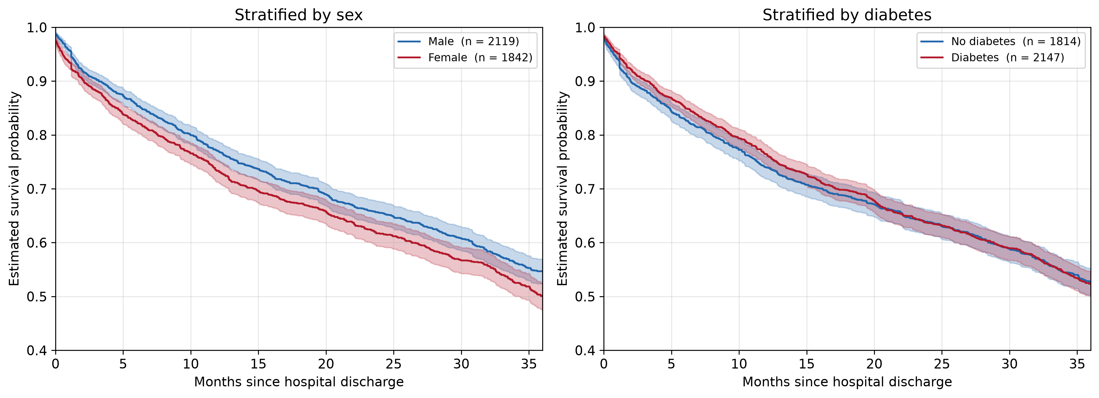
PA1: sex and diabetes
Backup
One-year survival 0.770 against 0.733 by sex, and 0.740 against 0.764 by diabetes. Neither separates the cohort.
Notes:
Backup: the two stratifications PA1 started from

Slide 21
Refitted Cox model — all sixteen terms
Backup
Covariate | HR (train) | 95% CI (train) | p (train) | HR (full) | p (full)
Age (years) | 1.0447 | 1.0384 – 1.0511 | < 0.001 | 1.0438 | < 0.001
BUN, discharge | 1.0238 | 1.0197 – 1.0279 | < 0.001 | 1.0213 | < 0.001
RDW | 1.1295 | 1.0963 – 1.1638 | < 0.001 | 1.1204 | < 0.001
ΔBUN | 0.9900 | 0.9861 – 0.9940 | < 0.001 | 0.9903 | < 0.001
BNP | 1.0002 | 1.0001 – 1.0002 | < 0.001 | 1.0002 | < 0.001
Sodium | 0.9726 | 0.9611 – 0.9843 | < 0.001 | 0.9728 | < 0.001
Length of stay | 1.0083 | 1.0020 – 1.0146 | 0.010 | 1.0094 | 0.001
Bilirubin | 1.0988 | 0.9738 – 1.2400 | 0.126 | 1.1208 | 0.037
Potassium | 0.9196 | 0.8376 – 1.0096 | 0.078 | 0.9141 | 0.038
Platelets | 1.0005 | 0.9998 – 1.0012 | 0.147 | 1.0004 | 0.100
Creatinine, discharge | 0.9172 | 0.8345 – 1.0080 | 0.073 | 0.9376 | 0.132
Comorbidity burden 2–3 | 0.8754 | 0.7181 – 1.0672 | 0.188 | 0.8885 | 0.195
White blood cells | 1.0001 | 0.9918 – 1.0085 | 0.976 | 1.0028 | 0.436
Female sex | 0.9809 | 0.8720 – 1.1035 | 0.749 | 0.9693 | 0.558
GFR, discharge | 1.0014 | 0.9975 – 1.0053 | 0.492 | 1.0010 | 0.585
Comorbidity burden 4+ | 0.9835 | 0.8046 – 1.2021 | 0.871 | 0.9882 | 0.898
Notes:
Backup: the full sixteen-term refitted model with confidence intervals. Use for any coefficient question.

Slide 22
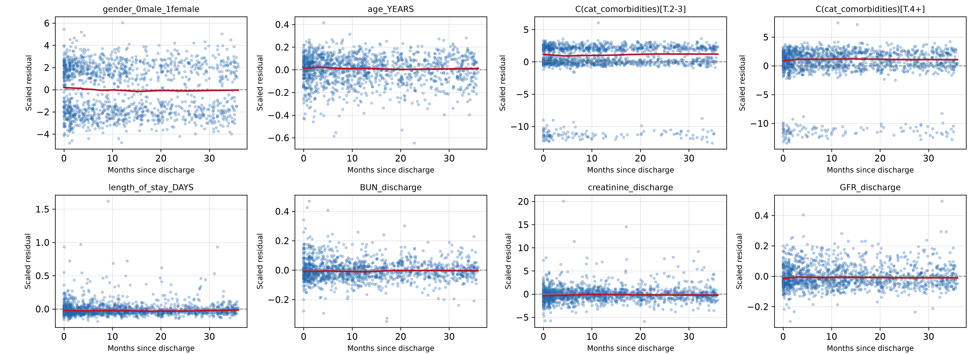
Scaled Schoenfeld residuals — training fit (1 of 2)
Backup
Lowess smoother in red. The comorbidity panels band because the variable enters as dummy indicators — coding, not a violation.
Notes:
Backup: Schoenfeld residual panels from the training fit, first eight terms. Smoothers are flat almost everywhere, with none of the steady drift a genuinely time-varying hazard ratio would produce. The terms flagged by the formal test look no different by eye from the rest.

Slide 23
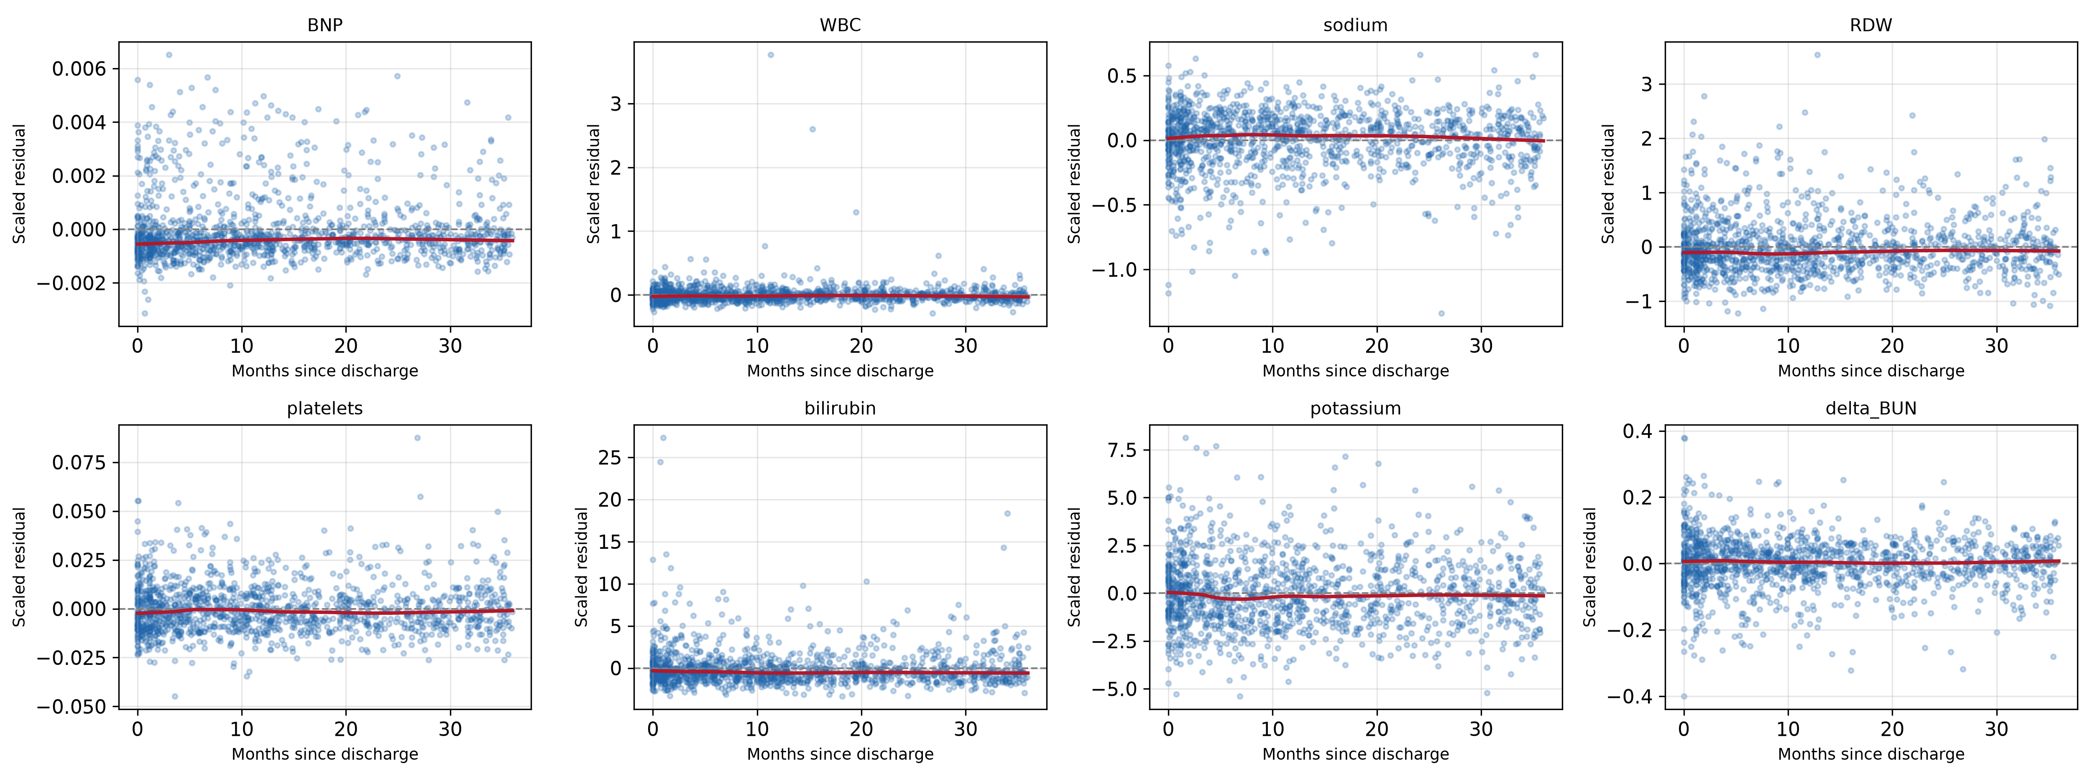
Scaled Schoenfeld residuals — training fit (2 of 2)
Backup
Panel titles are the raw model terms; delta_BUN is ΔBUN and C(cat_comorbidities) the comorbidity burden dummies.
Notes:
Backup: Schoenfeld residual panels from the training fit, remaining eight terms. Same reading — flat smoothers throughout.

Slide 24
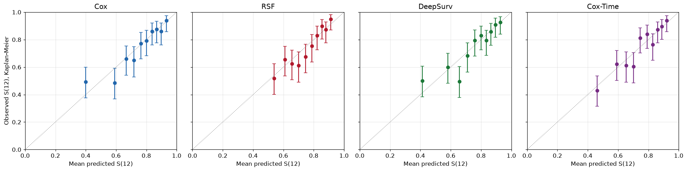
Calibration on the test set
Backup
Each point: decile mean predicted vs. Kaplan–Meier observed one-year survival, with 95% CIs. Cox has the lowest overall calibration error; the forest’s range is narrower than the observed outcomes.
Notes:
Backup: calibration on the test set. Deciles of predicted one-year survival; each point is the decile's mean prediction against its Kaplan-Meier observed survival, with 95% CIs, against the diagonal. Only about 80 patients per decile, so the intervals are wide and single points should not be over-read.
Cox has the lowest size-weighted mean absolute gap at 0.0367, though it separates two low-survival deciles that the observed data do not distinguish. DeepSurv has the largest single deviation. Cox-Time has several small deviations around the diagonal, which is why it is last on the summary measure despite having no severe miss. The forest's points cover a narrower range than the observed outcomes — the same compression that shows up in the risk tertiles.

Slide 25
Hyperparameter selection
Backup
Model | Selected configuration | CV IBS | SE
Cox (reference) | no tuning | 0.1097 | 0.0030
RSF | 500 trees, min leaf = 50, max features = 4 | 0.1116 | 0.0033
DeepSurv | hidden [16], dropout 0.4, lr 0.001, 119 epochs | 0.1096 | 0.0027
Cox-Time | hidden [16], dropout 0.4, lr 0.01, 32 epochs | 0.1105 | 0.0030
5-fold CV within the training set, folds drawn once and reused for all three models; one-SE rule selects the simplest configuration within one SE of the best.
Cox row is a same-folds reference that selected nothing; all four scores lie within one SE of each other.
Notes:
Backup: full tuning results. 5-fold CV within the training set, folds drawn once and reused for all three models, every configuration scored by IBS over the first year.
Grids searched: RSF minimum leaf size 5 / 15 / 30 / 50 crossed with max features 4 / 8 / 16; both networks over hidden layers [16], [32, 32], [64, 64], dropout 0.1 / 0.4, learning rate 0.01 / 0.001. Fixed: 500 trees, Adam, batch size 256, max 512 epochs, early stopping after ten epochs without improvement with best weights restored, standardised covariates.
Epochs were not tuned separately — 20% of each fold's fitting data was held out for early stopping, and the final networks were trained on all training patients for the average best-epoch count. The Cox row is scored on the same folds as a reference and selected nothing. All four scores lie within one SE of each other, which is why the one-SE rule pushed every model to the simplest end of its grid.

Slide 26
Predicted one-year survival: all four models
Backup
Covariate | Model | S at low | S at high | Drop over grid | Drop over IQR
Age (years) | Cox | 0.962 | 0.641 | 0.321 | 0.110
 | RSF | 0.924 | 0.627 | 0.297 | 0.118
 | DeepSurv | 0.945 | 0.584 | 0.361 | 0.105
 | Cox-Time | 0.946 | 0.633 | 0.313 | 0.114
RDW (%) | Cox | 0.864 | 0.659 | 0.205 | 0.034
 | RSF | 0.904 | 0.801 | 0.103 | 0.057
 | DeepSurv | 0.891 | 0.709 | 0.183 | 0.044
 | Cox-Time | 0.885 | 0.677 | 0.208 | 0.043
BUN, discharge | Cox | 0.876 | 0.298 | 0.577 | 0.064
 | RSF | 0.899 | 0.719 | 0.180 | 0.032
 | DeepSurv | 0.885 | 0.465 | 0.420 | 0.061
 | Cox-Time | 0.898 | 0.389 | 0.509 | 0.078
S at low / high are predictions at the grid ends (1st/99th training percentile); drop over IQR is the more clinically relevant number for a typical patient.
Notes:
Backup: the full prediction table for all four models. Same grids (1st to 99th training percentile) and the same representative patient throughout — the Cox rows reproduce the Cox-only table exactly, which is the check that all four models are evaluated on identical inputs.
Drop over the IQR is the number to quote for a typical patient; drop over the grid is dominated by the tails, which is why Cox and the forest differ by 0.40 on BUN there and by only 0.03 over the IQR.

Slide 27
Agreement between the four models on test-set risk
Backup
(a) Spearman rank correlation
(b) Overlap of top-risk quintiles
 | Cox | RSF | DeepSurv | Cox-Time
Cox | 1.000 | 0.884 | 0.976 | 0.976
RSF | 0.884 | 1.000 | 0.911 | 0.908
DeepSurv | 0.976 | 0.911 | 1.000 | 0.980
Cox-Time | 0.976 | 0.908 | 0.980 | 1.000
Model A | Model B | Shared n | Shared % | Jaccard
Cox | RSF | 113 | 71.1 | 0.551
Cox | DeepSurv | 141 | 88.7 | 0.797
Cox | Cox-Time | 140 | 88.1 | 0.787
RSF | DeepSurv | 124 | 78.0 | 0.639
RSF | Cox-Time | 117 | 73.6 | 0.582
DeepSurv | Cox-Time | 138 | 86.8 | 0.767
Panel (a): Spearman rank correlation of predicted risk. Panel (b): overlap of the top-risk quintiles, 159 patients per model.
Notes:
Backup: agreement between the models on individual test patients. Panel (a) is the Spearman rank correlation of predicted one-year risk; panel (b) is the overlap of the top-risk quintiles, 159 patients per model.
The three Cox-family models agree at 0.976 to 0.980 and share 87 to 89% of the top quintile. The forest sits apart at 0.884 to 0.911, sharing 71 to 78%. Jaccard is lower than the shared percentage because it counts the union in the denominator.

Slide 28
Test-set performance within subgroups
Backup
Subgroup | n (deaths) | Measure | Cox | RSF | DeepSurv | Cox-Time
BUN ≤ 28 mg/dL | 430 (81) | Uno's C | 0.7140 | 0.6946 | 0.7018 | 0.7079
 |  | IBS | 0.0901 | 0.0933 | 0.0910 | 0.0899
BUN > 28 mg/dL | 363 (118) | Uno's C | 0.6361 | 0.6173 | 0.6346 | 0.6349
 |  | IBS | 0.1446 | 0.1449 | 0.1441 | 0.1431
Age ≤ 76 years | 406 (62) | Uno's C | 0.6663 | 0.7010 | 0.6785 | 0.6815
 |  | IBS | 0.0787 | 0.0783 | 0.0786 | 0.0784
Age > 76 years | 387 (137) | Uno's C | 0.6172 | 0.5800 | 0.6085 | 0.6203
 |  | IBS | 0.1532 | 0.1574 | 0.1538 | 0.1519
Subgroups cut at training-set medians of discharge BUN (28 mg/dL) and age (76 years), so cut points do not depend on the test data.
Notes:
Backup: subgroup performance with IBS alongside Uno's C. Cuts at the training medians of discharge BUN (28 mg/dL) and age (76 years), so they do not depend on the test data.
Cox-Time has the lowest IBS in three of the four subgroups, with margins in the third or fourth decimal. Both measures get clearly worse in the high-BUN and older halves — 0.090 to 0.145 on IBS across the BUN split — which reflects how sick those patients are rather than a failure of any one model.

Slide 29
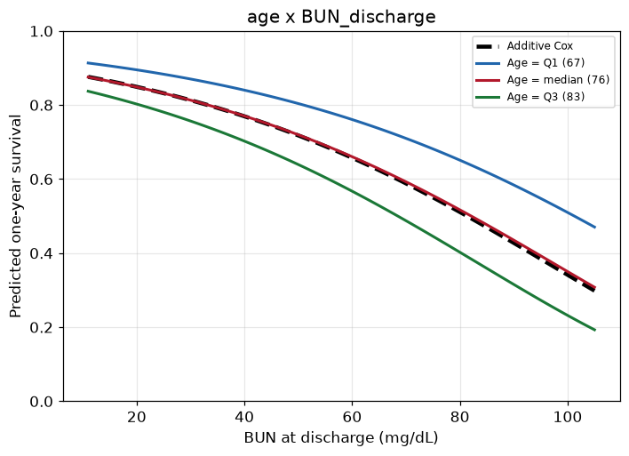
The age × discharge BUN interaction
Backup
Curves for age at Q1/median/Q3 of discharge BUN remain approximately parallel to the additive Cox model — consistent with the non-significant interaction test (LR p = 0.592).
Notes:
Backup: the age by discharge BUN interaction. The curves for age at Q1, median and Q3 of discharge BUN stay approximately parallel to the additive Cox model, which is what a non-significant interaction looks like — likelihood ratio 0.29 on 1 df, p = 0.592.
Contrast with the delta-BUN figure on the main slide, where the curves fan out. Adding this term leaves test C at 0.6955 and test IBS at 0.1151, both indistinguishable from the additive model.

